Slide 1
Vector Spaces
COORDINATE SYSTEMS

Slide 2
THE UNIQUE REPRESENTATION THEOREM
Theorem 8: Let B be a basis for vector space V. Then for each x in V, there exists a unique set of scalars c₁, …, c_{n} such that
(1)
Proof: Since B spans V, there exist scalars such that (1) holds.
Suppose x also has the representation
for scalars d₁, …, d_{n}.

Slide 3
THE UNIQUE REPRESENTATION THEOREM
Then, subtracting, we have
(2)
Since B is linearly independent, the weights in (2) must all be zero. That is, for .
Definition: Suppose B is a basis for V and x is in V. The coordinates of x relative to the basis B (or the B-coordinate of x) are the weights c₁, …, c_{n} such that .

Slide 4

THE UNIQUE REPRESENTATION THEOREM
If c₁, …, c_{n} are the B-coordinates of x, then the vector in
[x]_{B}
is the coordinate vector of x (relative to B), or the B-coordinate vector of x.
The mapping _{B} is the coordinate mapping (determined by B).
$$ℝ^{n}$$

Slide 5



COORDINATES IN
$$ℝ^{n}$$
When a basis B for is fixed, the B-coordinate vector of a specified x is easily found, as in the example below.
Example 1: Let , , , and
B . Find the coordinate vector [x]_{B} of x relative to B.
Solution: The B-coordinate c₁, c₂ of x satisfy
$$ℝ^{n}$$
b₁
b₂
x

Slide 6
COORDINATES IN
$$ℝ^{n}$$
or
(3)
This equation can be solved by row operations on an augmented matrix or by using the inverse of the matrix on the left.
In any case, the solution is , .
Thus and
.
b₁
b₂
x

Slide 7
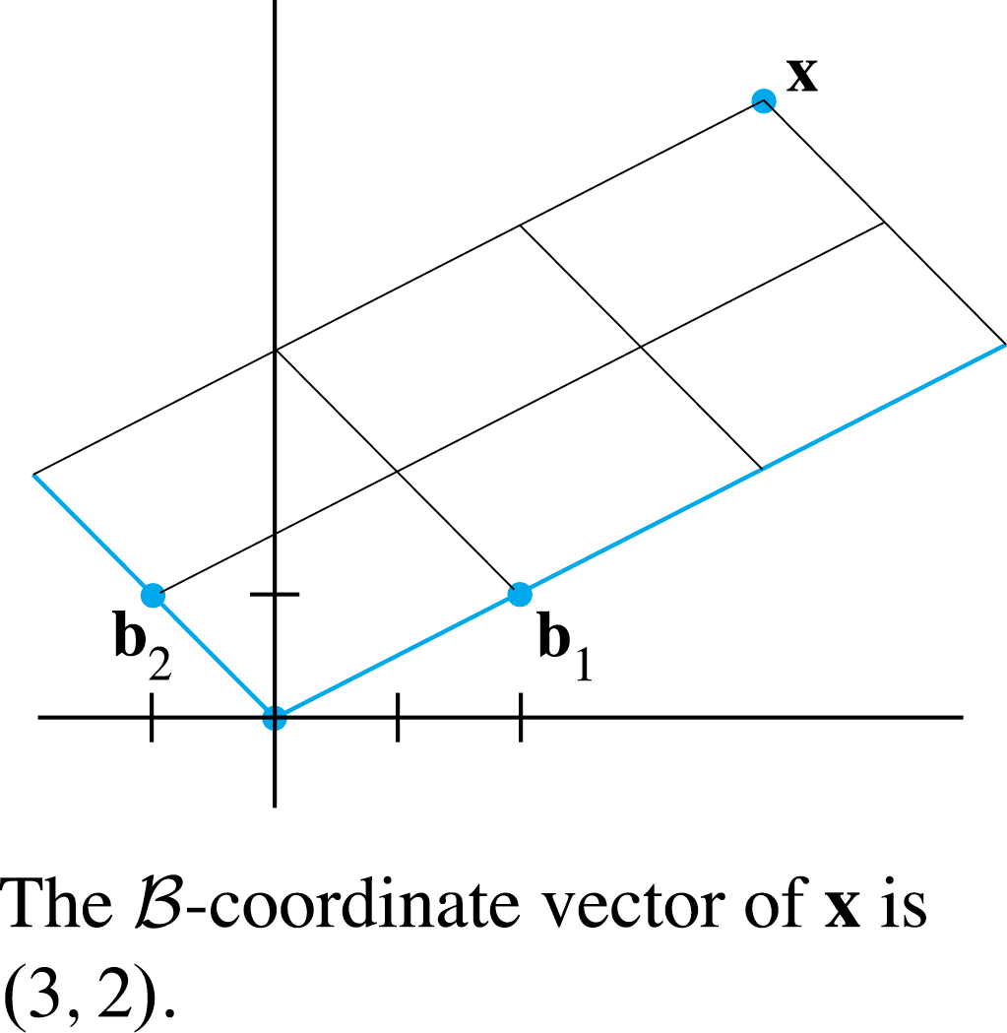

COORDINATES IN
$$ℝ^{n}$$
See the following figure.
The matrix in (3) changes the B-coordinates of a vector x into the standard coordinates for x.
An analogous change of coordinates can be carried
out in for a basis B .
Let P_{B}
$$ℝ^{n}$$

Slide 8


COORDINATES IN
$$ℝ^{n}$$
Then the vector equation
is equivalent to
(4)
P_{B} is called the change-of-coordinates matrix from B to the standard basis in .
Left-multiplication by P_{B} transforms the coordinate vector [x]_{B} into x.
Since the columns of P_{B} form a basis for , P_{B} is invertible (by the Invertible Matrix Theorem).
$$ℝ^{n}$$
$$ℝ^{n}$$

Slide 9



COORDINATES IN
$$ℝ^{n}$$
Left-multiplication by converts x into its B-coordinate vector:
The correspondence _{B}, produced by , is the coordinate mapping.
Since is an invertible matrix, the coordinate mapping is a one-to-one linear transformation from onto , by the Invertible Matrix Theorem.
$$ℝ^{n}$$
$$ℝ^{n}$$

Slide 10

THE COORDINATE MAPPING
Theorem 8: Let B be a basis for a vector space V. Then the coordinate mapping _{B} is a one-to-one linear transformation from V onto .
Proof: Take two typical vectors in V, say,
Then, using vector operations,
$$ℝ^{n}$$

Slide 11
THE COORDINATE MAPPING
It follows that
So the coordinate mapping preserves addition.
If r is any scalar, then

Slide 12
THE COORDINATE MAPPING
So
Thus the coordinate mapping also preserves scalar multiplication and hence is a linear transformation.
The linearity of the coordinate mapping extends to linear combinations.
If u₁, …, u_{p} are in V and if c₁, …, cp are scalars, then
(5)

Slide 13

THE COORDINATE MAPPING
In words, (5) says that the B-coordinate vector of a linear combination of u₁, …, u_{p} is the same linear combination of their coordinate vectors.
The coordinate mapping in Theorem 8 is an important example of an isomorphism from V onto .
In general, a one-to-one linear transformation from a vector space V onto a vector space W is called an isomorphism from V onto W.
The notation and terminology for V and W may differ, but the two spaces are indistinguishable as vector spaces.
$$ℝ^{n}$$

Slide 14

THE COORDINATE MAPPING
Every vector space calculation in V is accurately reproduced in W, and vice versa.
In particular, any real vector space with a basis of n vectors is indistinguishable from .
Example 2: Let , , ,
and B . Then B is a basis for
. Determine if x is in H, and if it is,
find the coordinate vector of x relative to B.
$$ℝ^{n}$$

Slide 15
THE COORDINATE MAPPING
Solution: If x is in H, then the following vector equation is consistent:
The scalars c₁ and c₂, if they exist, are the B-coordinates of x.

Slide 16

THE COORDINATE MAPPING
Using row operations, we obtain
.
Thus , and [x]_{B} .
$$\left[\begin{matrix}3 & −1 & 3 \\ 6 & 0 & 12 \\ 2 & 1 & 7\end{matrix}\right]∼\left[\begin{matrix}1 & 0 & 2 \\ 0 & 1 & 3 \\ 0 & 0 & 0\end{matrix}\right]$$

Slide 17
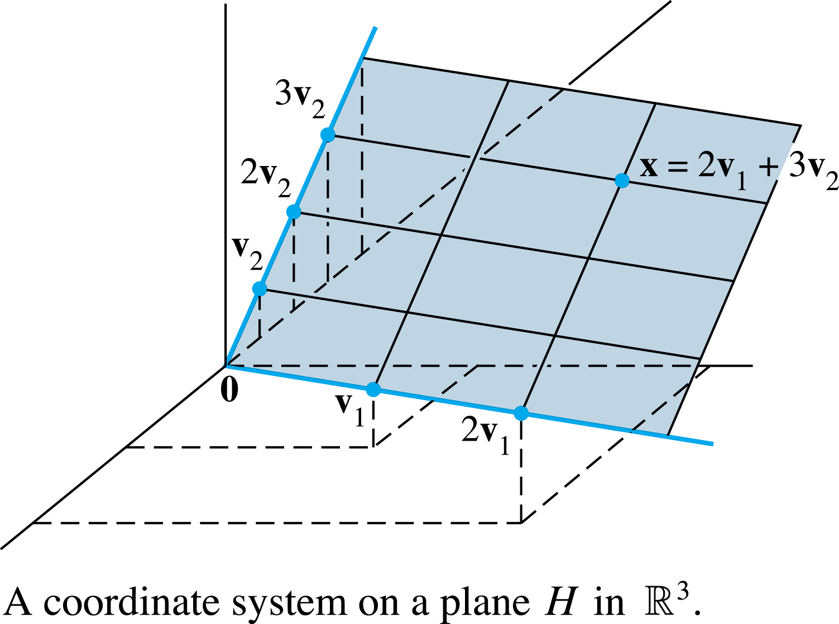
THE COORDINATE MAPPING
The coordinate system on H determined by B is shown in the following figure.

